Slide 1

Understanding the basic web development framework
Presented by : k.Unnathi singh
(22h51a0594) cse-d

Slide 2
Introduction to Web development
What is web development?
Web development is the process of creating and maintaining websites and web applications that are accessible over the internet. It involves a combination of front-end (client-side) and back-end (server-side) development.
Why it is important?
Global Accessibility
Business Growth
Information Sharing

Slide 3
Components of web development
1. Front-End Development:
Definition: The visual part of the website that users interact with.
Languages: HTML, CSS, JavaScript
Frameworks/Libraries: React, Angular, Vue.js
2. Back-End Development:
Definition: The server-side logic, databases, and application functionality.
Languages: Python, Node.js, Ruby, PHP
Frameworks: Django, Flask, Express, Ruby on Rails
3. Full-Stack Development:
Definition: Involves both front-end and back-end development.
Popular Stacks: MERN (MongoDB, Express, React, Node.js), LAMP (Linux, Apache, MySQL, PHP)

Slide 4
The web development process
1. Planning & Research:
Identify the purpose, target audience, and key features of the website.
2. Design:
Create wireframes, mockups, and prototypes to visualize the user interface.
3. Development:
Front-End Development: Build the user interface.
Back-End Development: Implement the server-side logic and database.
4. Testing & Deployment:
Test for bugs, security, and performance.
Deploy to a live server and monitor for issues.

Slide 5
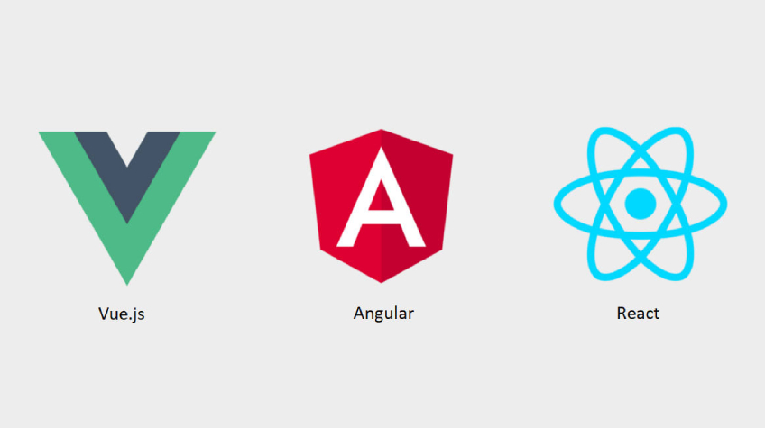
Common front end frameworks
1. React:
Developed by Facebook, used for building reusable UI components.
2. Angular:
Developed by Google, used for building single-page applications (SPAs).
3. Vue.js:
A progressive JavaScript framework that is easy to integrate with other projects.

Slide 6



Common back-end frameworks
1. Django:
A Python-based framework known for its "batteries-included" philosophy.
2. Flask:
A lightweight Python framework, suitable for small to medium applications.
3. Express.js:
A minimal and flexible Node.js framework for building web applications and APIs.

Slide 7

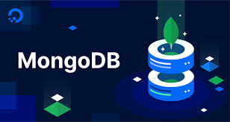
Data bases in web development
Relational Databases:
Examples: MySQL, PostgreSQL
Data is organized into tables.
NoSQL Databases:
Examples: MongoDB, Firebase
Data is stored in formats like JSON, suitable for unstructured data.

Slide 8
The role of API’s
What is an API?
Application Programming Interface: a set of rules that allows different software entities to communicate.
RESTful API’s:
RESTful API is an interface that two computer systems use to exchange information securely over the internet. Most business applications have to communicate with other internal and third-party applications to perform various tasks.

Slide 9


